Slide 1

Classifying Music
Adam Burrows, Jaycie Jackson, Nick Zamora

Slide 2


Introduction
Motivation
Personal: Practice machine learning techniques for unstructured data
Business: Efficiently classify songs for new music streaming apps
Related Work
Voice recognition
Voice to text conversion
Shazam
Speech Synthesis
Problem Statement
Utilize machine learning to correctly classify songs by genre
Expected Results
Validation score better than random chance (1/8)

Slide 3
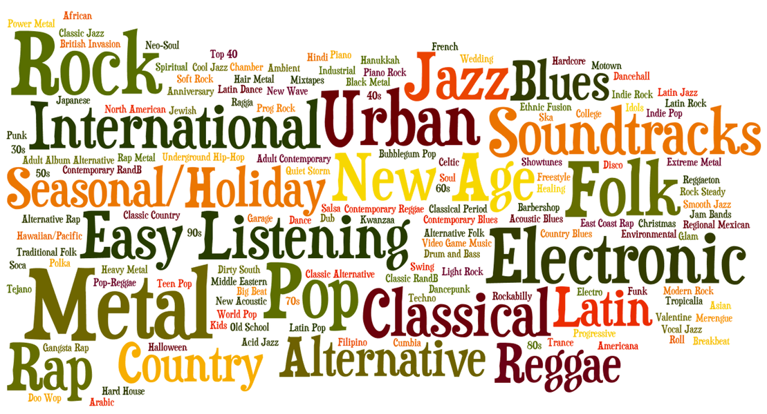
Our Data
Github - Mdeff
Totals:
8000 songs in MP3 form
30s in length
8 balanced categories
7.2 GiB of memory
Extracted MFCC for each song
Mel-frequency Cepstral Coefficients
Mimics the logarithm perception of loudness pitch accounting for speaker characteristics
Keras
Package in Python to create Neural Networks

Slide 4
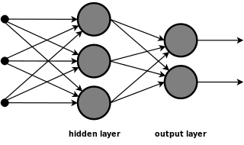
Data Analysis
1st step: Split data into 70% training - 30% validation
Used for each model
2nd step: Create Deep Neural Network (DNN)
One visible layer, One hidden layer
88,584 trainable parameters, 100 epochs
3rd step: Create Convolutional Neural Network (CNN) - 1 dimensional layers
flatten the model back to one-dimensional
Two visible layers
255,656 trainable parameters, 50 epochs
4th step: Create a CNN - 2 dimensional layers
Four visible layers
2,796,648 trainable parameters, 50 epochs
5th step: Compare 3 models

Slide 5
DNN Model
Trainable parameters: 88,584
Batch size: 32
Optimizer: Adam
Input
7,997x80
Dense
Dropout
50%
Dense
Dropout
50%
Dense
Output:
1x256
1x256
1x8

Slide 6
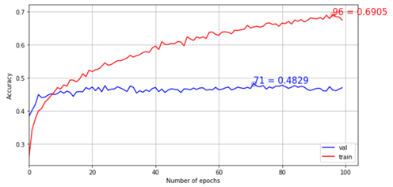
2D Results

Slide 7
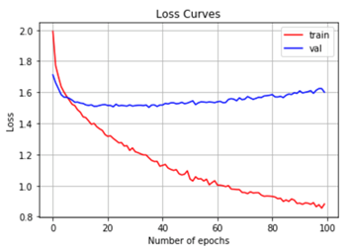
2D Results

Slide 8
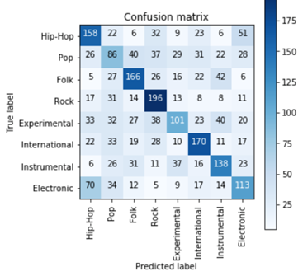
2D Results

Slide 9
First CNN layer
Input
7,980@
80x2500
Pooling
@
length=2
Batch normalization
Dropout
15%
Conv1D
32@
length=3
Output:
1x78
1x39

Slide 10
Second CNN layer
Pooling
@
length=2
Batch normalization
Dropout
15%
Conv1D
64@
length=3
Output:
1x37
1x18

Slide 11
CNN Output
Trainable parameters: 255,656
Batch size: 32
Optimizer: Adam
Regularizer: l2=0.1
Flatten
Dense
Output:
1x1152
1x8

Slide 12
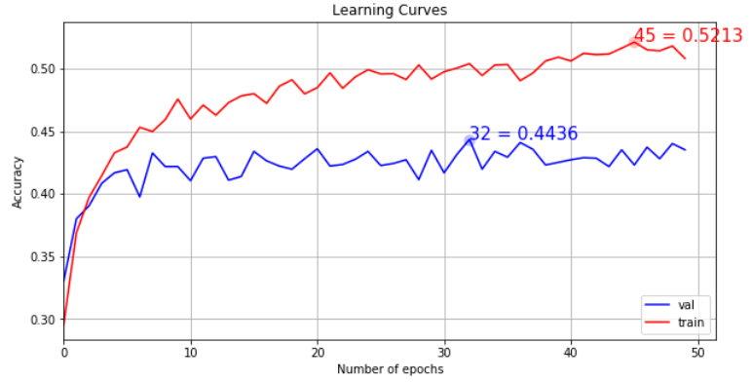
3D Results

Slide 13
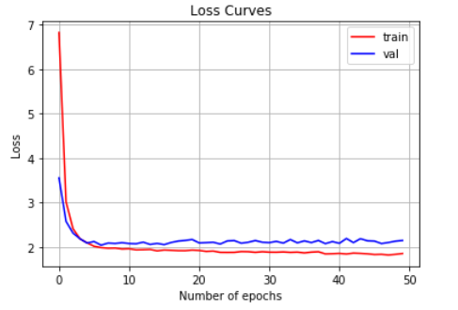
3D Results

Slide 14
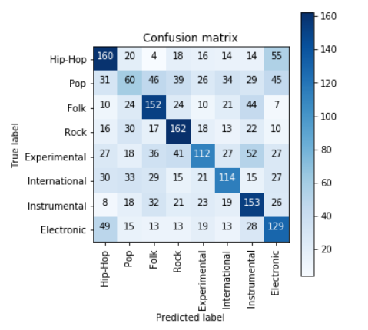
3D Results

Slide 15
First CNN layer
Input
7,997@
96x1366
Pooling
2x2
Batch normalization
Dropout
15%
Conv2D
32@
3x3
Output:
94x1364
47x682

Slide 16
Second CNN layer
Pooling
2x2
Batch normalization
Dropout
15%
Conv2D
64@
3x3
Output:
45x680
22x340

Slide 17
Third CNN layer
Pooling
2x2
Batch normalization
Dropout
15%
Conv2D
64@
3x3
Output:
20x338
10x169

Slide 18
Fourth CNN layer
Pooling
2x2
Batch normalization
Dropout
15%
Conv2D
32@
3x3
Output:
8x167
4x83

Slide 19
CNN Output
Trainable parameters: 2,796,648
Batch size: 32
Optimizer: Adam
Dense
Dropout
15%
Flatten
Dense
Output:
1x10624
1x256
1x8

Slide 20
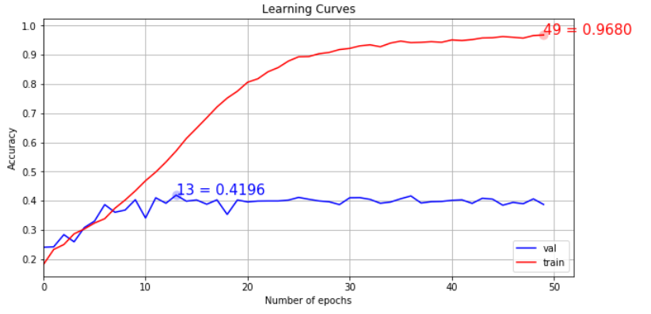
4D Results

Slide 21
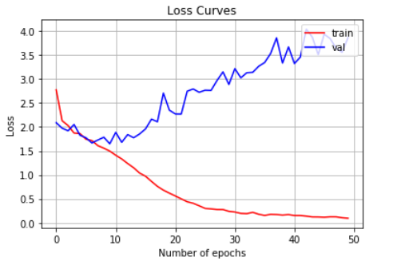
4D Results

Slide 22
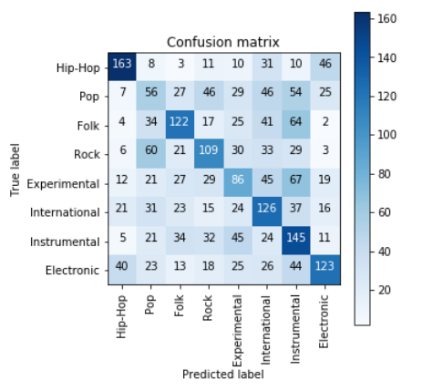
4D Results

Slide 23
Summary of models
 | Train % | Val % | Loss | Val Loss
2D | 69 | 48 | 0.85 | 1.5
3D | 52 | 44 | 1.9 | 2.01
4D | 97 | 42 | 0.1 | 3.5

Slide 24

Conclusions and Takeaways
Best Model: Convolutional Neural Network (3D model)
Validation score (44% overall)
Top 3 genres by validation score: Rock, International, Hip-Hop
Best position for improvement, no overfitting
Challenges:
Overfitting models to training set
Lack of Power in multi-classification for big data
Computationally exhausting
Future Plans
Segment features (such as mfcc) into smaller time blocks
1, 30s block → 6, 5s blocks
10ms overlap
Better represent features, more information

Slide 25
Works Cited
“Mdeff/Fma.” GitHub, github.com/mdeff/fma.
Python lab cloud link: http://129.114.108.202:8888/lab?
Look under folder ‘Dr. Rad – final models’ for our best work

